Slide 1
Webapp development with no front-end skills
Nicolas Fränkel
JEE Conf, Kiev, May 2014

Slide 2
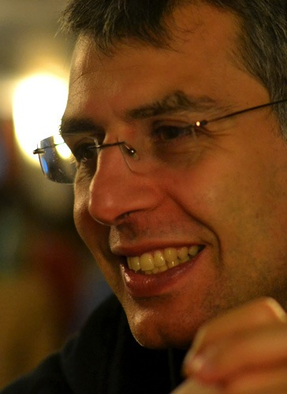
Me, myself and I
Developer & Architect as consultant
  Wide range of businesses & customers
Teacher & Trainer
Blogger
  blog.frankel.ch
  morevaadin.com

Slide 3



Also an author

Slide 4
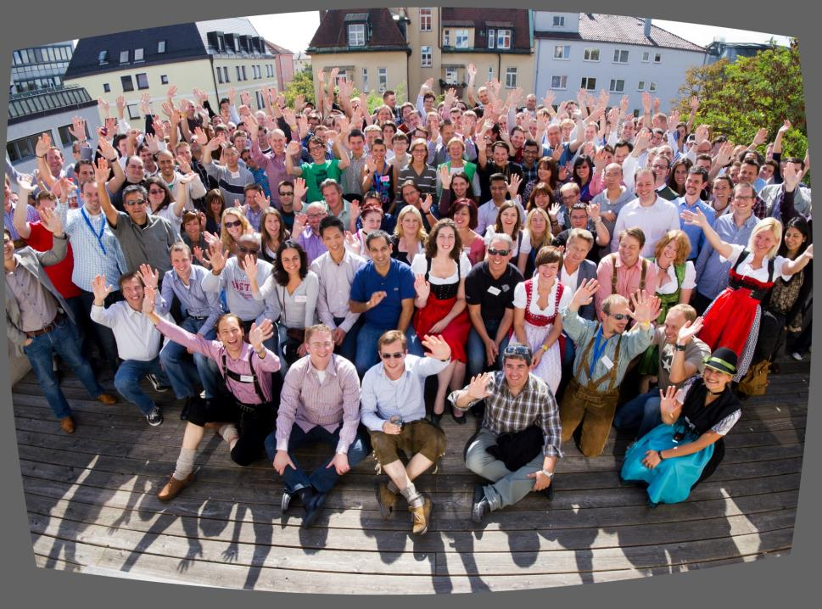

E-commerce company
Rocks
Sends employees to Oktoberfest

Slide 5

Java Web Development
JavaScript
DOM
AJAX
Taglib
HTML
JSP
Java
Servlet API
CSS
HTTP

Slide 6



Vaadin Development
Java

Slide 7
Enough!
Let’s code
Especially me…

Slide 8


Thank you for your interest
@nicolas_frankel
@learnvaadin
@itfromtrenches
http://blog.frankel.ch/
http://morevaadin.com/

